Slide 1



Summer
2026
Camps

Slide 2

When School’s Out, We’re In!
Little Scholars has proudly partnered with The University of Richmond for the past 16 summers and we are excited for another great year!
Little Scholars delivers top-tier enrichment programs to school districts and independent schools throughout the US. We tailor our program to individual needs and interests because every child and school community is unique. We pride ourselves in providing world-class customer service by anticipating our customers' needs.

Slide 3


Eligibility
Camps are free for full-time employees, but registration for each child is required.
Employees must use their own name and University email address for registration. Spouse name and/or personal email accounts cannot be processed.
Employee's eligible dependents must be verified and listed in Workday by Monday, February 9th in order to enroll in camps. Enrollment will not be processed without the required documentation.
Registration is through the Little Scholars portal - URHR does not manage camp registration.
Employees/dependents do not need to be enrolled in a university medical plan to participate.
Enrollment in these programs does not use tuition remission credits.
Age/Grade Level
Rising Kindergarten (child must be enrolled to attend Kindergarten in Fall 2026)
Rising 1st – rising 2nd grade
Rising 3rd – rising 4th grade
Rising 5th – rising 6th grade

Slide 4
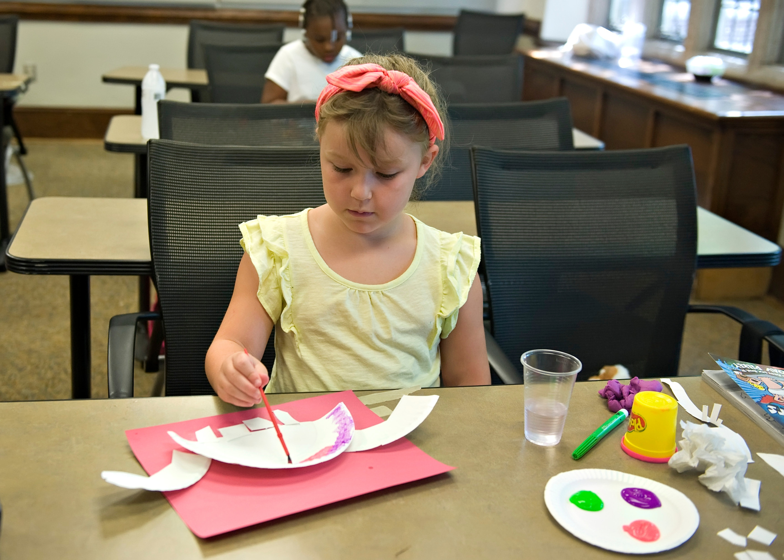
Registration Reminders
2026 Summer Camp registration will open on Monday, February 2nd at 5:30 p.m. and will close on Monday, February 9th at 5:00 p.m.
Registration will be available through the weekend, but it is recommended that you register early, as spaces fill up quickly.
Acceptance is first-come, first-serve based on the time of registration.
Registration Link: https://www.littlescholarsllc.com/at/ur-summer-youth-programs/
If you registered last year, you can use your same account. New families will need to create an account at the time of registration. (takes 5 minutes, tops!)
In order to expedite your registration:
Employee's eligible dependents must be verified and listed in Workday by the end of registration on Monday, February 9th to avoid removal from the camp. Enrollment will not be processed without the required documentation. If dependent has already been verified you can skip this step.
If you are registering for the first time, you can set up your Sawyer account here (https://www.hisawyer.com). If you are a returning user, please ensure that you have your login credentials available.
Acceptance is immediate until classes are full. Once a class is full, your dependent will be placed on a waitlist for that week and you will be notified if space opens up.
Little Scholars manages camp registration. Any questions regarding waitlist status or camp registration should be directed to Nicole Brown at Little Scholars or 804-447-4095.

Slide 5

Camp Weeks and Themes
JUNE 15TH-18TH THE GREAT GREEN ADVENTURE
JUNE 22ND-26TH JOURNEY THROUGH THE WILD
JULY 6TH-10TH TINKER TANK
JULY 13TH-17TH SCIENCE PALOOZA
JULY 20TH-24TH ARTVENTURE
JULY 27TH-31ST LET’S MOVE
AUGUST 3RD-7TH BACK TO SCHOOL BASH

Slide 6
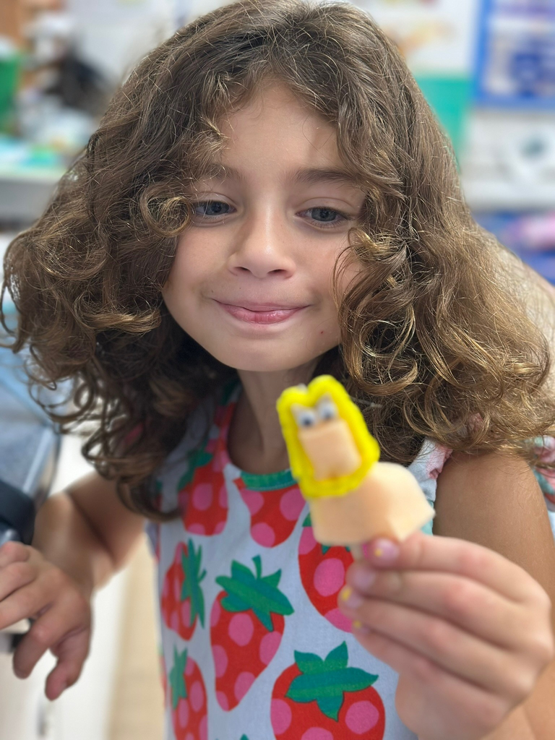
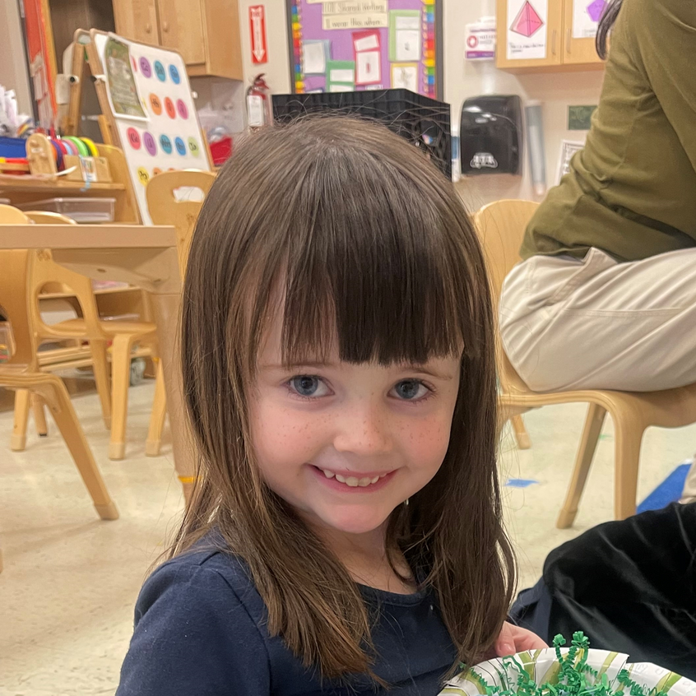

Before and After Care
BEFORE CARE: 8 A.M. - 9 A.M., M-F ($40/WEEK PER STUDENT)
CAMP SESSION: 9 A.M. - 4 P.M.
AFTER CARE: 4 P.M. - 5:15 P.M., M-F ($45/WEEK PER STUDENT)
REGISTRATION FOR BEFORE AND AFTER CARE IS ONGOING AND STUDENTS CAN BE ADDED AT ANY TIME FOR ANY SPECIFIC WEEK(S) THEY NEED AS LONG AS AT LEAST 1 STUDENT IS ENROLLED.
EMPLOYEE IS RESPONSIBLE FOR THE COST OF BEFORE AND AFTER CARE. IF YOU ARE ENROLLED IN THE DEPENDENT CARE FSA, YOU MAY BE ABLE TO USE YOUR DCFSA FUNDS TO PAY FOR BEFORE AND AFTER CARE!

Slide 7

Cancellations
IF YOUR DEPENDENT IS ENROLLED IN A CAMP AND WILL BE UNABLE TO ATTEND, YOU MUST NOTIFY LITTLE SCHOLARS AS SOON AS POSSIBLE TO AVOID BEING CHARGED A CANCELLATION FEE.
No fee will be charged if you cancel a camp by Friday, April 24th.
An administrative fee of $50 per child, per week will be charged if you cancel a camp after Friday, April 24th. This fee will be deducted from the employee’s next paycheck.
If a participant's guardian does not provide cancellation notice prior to the start of a program and the child does not attend the program, a no-show fee of $100 per child per week will be deducted from the employee’s next paycheck. Exceptions will be made for a child’s illness only if a legitimate doctor’s note is provided.
This cancellation policy does NOT apply to Before and After Care.

Slide 8


Contact Information
NICOLE BROWN
PROGRAM COORDINATOR
804-447-4095 NBROWN@LITTLESCHOLARSLLC.COM
JONATHAN WILLIAMS
SUMMER PROGRAMS COORDINATOR
804-289-8934 OR JWILLIA7@RICHMOND.EDU
ELIGIBILITY
804-289-8747
URHR@RICHMOND.EDU
AVERY DAVIS
CHIDI EZE
JULIANA SILVA

Slide 9
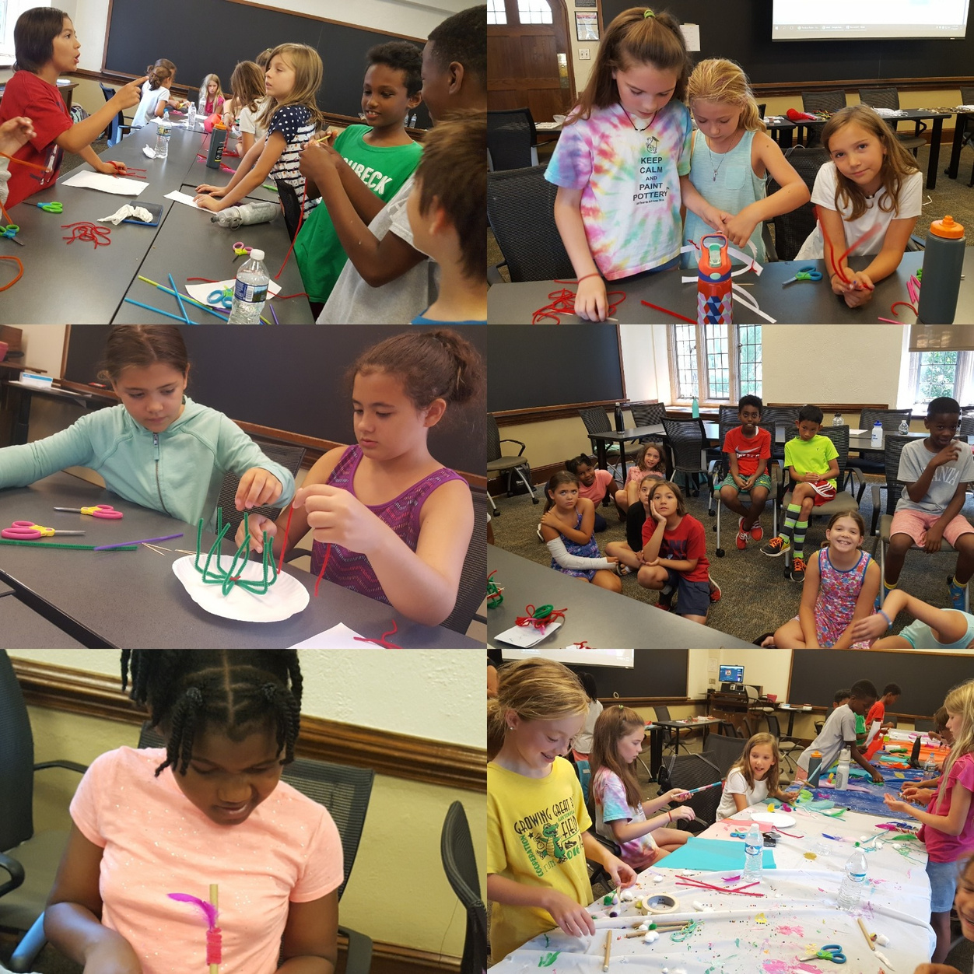
We look forward to seeing your little scholar this summer!
THANK YOU!

